Slide 1
COMP 3069 Computer Graphics
Lecture 7:
Light & Texture I
Autumn 2018

Slide 2
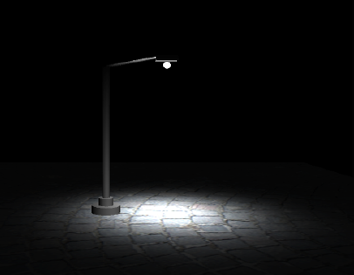
Coming Topics: Rendering
Light models
Ambient, Diffuse, Specular
Phone Reflection Model
Shading models
Gouraud shading
Phong shading

Slide 3
Rendering
Rendering determines the most appropriate colour to assign to a pixel associated with an object in a scene, according to light intensity at the pixel
What we think light is ? - In computer graphics we consider the light we see as the result of interaction of light with a surface / polygon, or light is reflected by the surface / polygon
How we calculate light ? - We calculate light intensity at a particular point on the surface based on some reflection models / methods. We then use some shading models to calculate light for a surface from lights at points (interpolation)

Slide 4
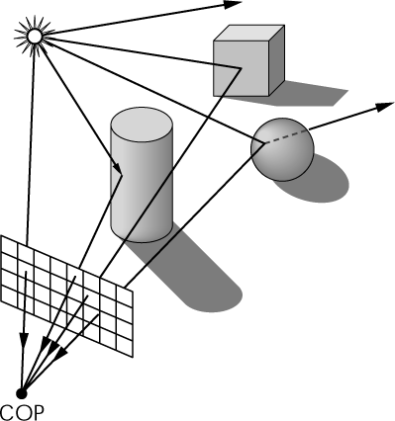
Light Models
Light models simulate the light reflected from a surface and the effect it has on the object.
The emphasis of light models is computational efficiency, rather than physical or optical correctness.
For real-time speed we approximate it with point light source (or set of point sources). A point light has a position.
Directional light has a direction but no specific position/origin. All light rays are assumed to be parallel to each other.

Slide 5
Types of Light Models
Ambient light – light is reflected with the same intensity everywhere, and appears to have no direction, as if reflected from other surfaces. Position of light is irrelevant
Diffuse light – light from a point source that radiates equally in all directions. The angle by which the light hits the surface affects the brightness by which the object is lit. Position of light is relevant
Specular light – light from a point source reflected in a mirror-like fashion toward the viewer. Both position of light and position of the viewer are used in calculating specular light

Slide 6
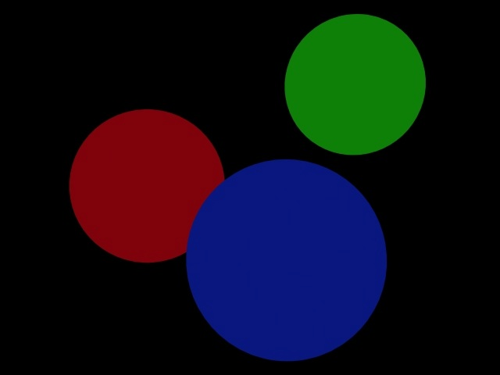
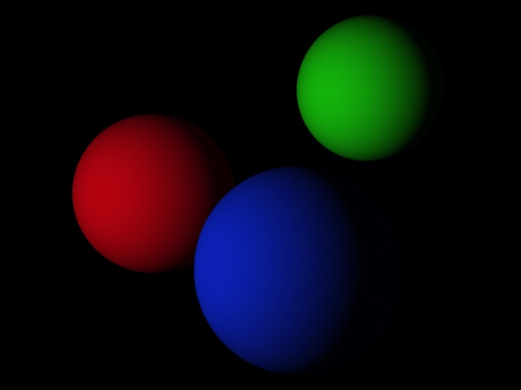

Ambient, Diffuse, Specular Lights

Slide 7
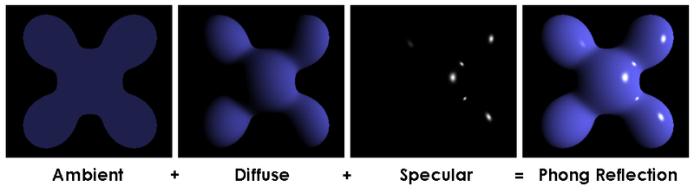
Phong Reflection Model for Calculating Light Intensity at a Point
The Phong model was presented by Phong
in his PhD dissertation (1973, University of Utah) "Illumination for Computer Generated Pictures”, a model based on observations.
It is used to calculate light intensity at a vertex, which is then multiplied by the colour (R,G,B separately) of the vertex render the vertex.

Slide 8
Phong Reflection Model – Calculating Light Intensity at Point
It uses four vectors to calculate light intensity at a point on a surface
V = Direction of the viewer (COP)
R = Direction of perfect reflection
N = Surface normal
L = Direction of light source
light
source
N
R
L
eye
V
surface

Slide 9
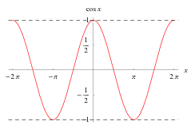
Phong Reflection Model - Calculating Light Intensity at Point
Ambient: light is the same everywhere and appears to have no direction:
I_{a} = K_{a} * L_{a}
I_{a} = Light intensity
K_{a} = Reflection coefficient
L_{a} = Intensity of incoming light
Diffuse: light intensity depends on the angle between L and N (strongest when = 0):
I_{d} = K_{d} * L_{d} * (L dot N)
= K_{d}* L_{d}* |L| * |N| * cos( )
I_{d} = Reflected intensity
K_{d} = Diffuse reflection coefficient
L_{d} = Intensity of light source
θ
θ
θ
light
source
R
N
L
eye
V
θ
φ
surface

Slide 10
Phong Reflection Model - Calculating Light Intensity at Point
Specular: light intensity depends on the angle between R and V (strongest when = 0):
I_{s} = K_{s} * L_{s} * ( R dot V)^{n}
= K_{s} * L_{s} * ( |R| * |V| * cos( ) ) ^{n}
φ
φ
light
source
N
R
L
eye
θ
V
φ
surface

Slide 11
Examples of Specular Lights
With different exponent n, n increases, light decrease much more quickly => smaller spot
I_{s} = K_{s} * L_{s} * ( R dot V)^{n}
= K_{s} * L_{s} * ( |R| * |V| * cos( ) ) ^{n}
φ
φ
light
source
L
surface

Slide 12
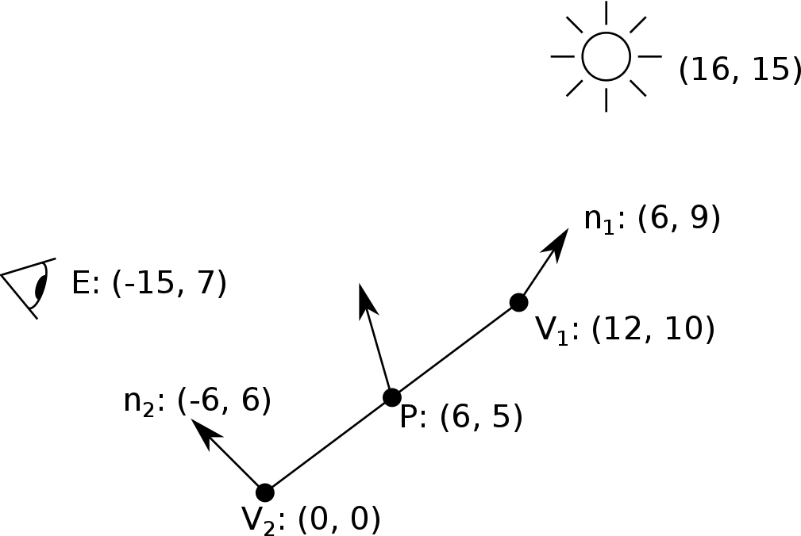
Example
In the scene below, given the eye position (-15,7) and the light source position (16,15), calculate the L, V, N vectors at point P (6,5) on the surface. You may assume that P is in the centre of v₁v₂.

Slide 13
Example
The light direction L is:
L= light – P = (16, 15) - (6, 5) =(10, 10)
The view direction V is:
V = Eye – P = (-15, 7) – (6, 5) = (-21, 2)
The normal direction N can be interpolated between the two normals n₂ (-6, 6) and n₁ (6, 9). As the point P is half way between the two normals, we can calculate N:
N = 0.5 × n1 + 0.5 × n2
= 0.5 × (6 ,9) + 0.5 × (-6, 6 ) = (0, 7.5)

Slide 14
Linear Interpolation
From the two similarity triangles we have:
P₂(x2,y2)
1−α
P(x,y)
α
P₁(x1,y1)
So (any)thing at P is
thing_{P} = (1-α) thing_{P1} + α thing_{P2}
Say P divides P₁ P₂ at the
ratio of α : 1- α .

Slide 15
OpenGL Light
// Set position of light
position[0] = 0.0; // x coordinate
position[1] = 0.0; // y coordinate
position[2] = 1.0; // z coordinate
position[3] = 1.0; // positional light
// Set ambient colour of light
ambient[0] = 0.15;
ambient[1] = 0.15;
ambient[2] = 0.1;
ambient[3] = 1.0;
// Set diffuse colour of light
diffuse[0] = 0.8;
diffuse[1] = 0.0;
diffuse[2] = 0.0;
diffuse[3] = 1.0;
// Set specular colour of light
specular[0] = 1.0;
specular[1] = 1.0;
specular[2] = 1.0;
specular[3] = 1.0;
OpenGL approximates light as if light can be broken into
red, green, blue colour, and alpha components (so the 4D vectors for each type of light), where alpha is the opacity (transparency) value.

Slide 16
OpenGL Light
glEnable(GL_LIGHTING);
glLightfv(light, pname, params);
light - specifies a light, identified by symbolic names of the form GL_LIGHT0, GL_LIGHT1, .. GL_LIGHT8
pname - specifies a light parameter, which can be
GL_AMBIENT, GL_DIFFUSE, GL_SPECULAR, GL_POSITION, GL_SPOT_CUTOFF, GL_SPOT_DIRECTION, GL_SPOT_EXPONENT, GL_CONSTANT_ATTENUATION, GL_LINEAR_ATTENUATION, and GL_QUADRATIC_ATTENUATION.
params - specifies a pointer to the value of pname e.g.,
light_position[] = { 1.0, 1.0, 1.0, 1.0 };
glLightfv(GL_LIGHT0, GL_POSITION, light_position);
Notes:
You

Slide 17
Example OpenGL Code - Setting Ambient, Diffuse, Specular Lights
glLightfv(GL_LIGHT0, GL_AMBIENT, ambient);
glLightfv(GL_LIGHT0, GL_DIFFUSE, diffuse);
glLightfv(GL_LIGHT0, GL_SPECULAR, specular);

Slide 18
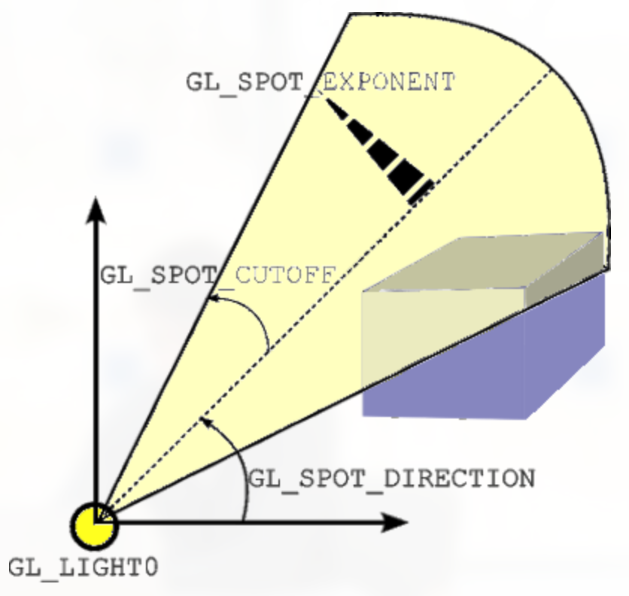
Example OpenGL Code:- Setting up Spotlight
Spotlight emits a cone shaped light
Its parameters also include
light direction
spread of the cone
spot_direction[] = { -1.0, -1.0, 0.0 };
glLightfv(GL_LIGHT0, GL_SPOT_DIRECTION, spot_direction);
glLightf(GL_LIGHT0, GL_SPOT_CUTOFF, 45.0);
glLightf(GL_LIGHT0, GL_CONSTANT_ATTENUATION, 2.0); glLightf(GL_LIGHT0, GL_LINEAR_ATTENUATION, 1.0); glLightf(GL_LIGHT0, GL_QUADRATIC_ATTENUATION, 0.5);

Slide 19
Flat Shading Model – Calculating Light Intensity for Surface
Shading assigns brightness and colour to a polygon
In flat shading, the normal of the polygon is used to shade the entire polygon uniformly. A ‘scan line’ is used to fill a polygon with a constant colour
N

Slide 20
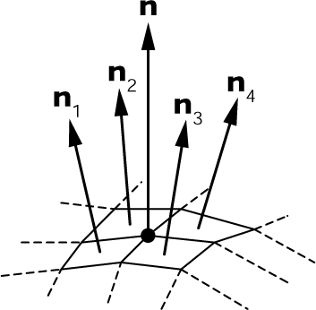
Gouraud Shading Model – Calculating Intensity on Surface
Gouraud shading begins by calculating the normal at each vertex, which is the average of normals of its neighbouring polygons
It then uses the reflection model to calculate intensity at each vertex, then interpolates the intensities across the surface

Slide 21
Gouraud Shading Model – Calculating Intensity on Surface (Cont’d)
We can use linear interpolation to calculate light intensity at any point P on the edge
I_{P} = (1-α) I_{P1} + α I_{P2}
where P divides P1 P2 in the ratio α : 1−α
Similarly to get light intensity at Q using P3 and P4
Then linear interpolation to calculate light for points on PQ
P3
P2
1-α
P
Q
α
P1
P4
P3
P2
P
Q
P1

Slide 22
Phong Shading Model – Calculating Intensity on Surface
In Phong shading, there are three values to interpolate, Nx, Ny and Nz (three components of the normal vector), in contrast to Gouraud shading, which has one value to interpolate
It then applies the Phong reflection model at each pixel to calculate the intensity
P3
P2
N2
N
P
Q
N1
P1
P4
P3
P2
N2
N
P
Q
N1
P1
P4

Slide 23
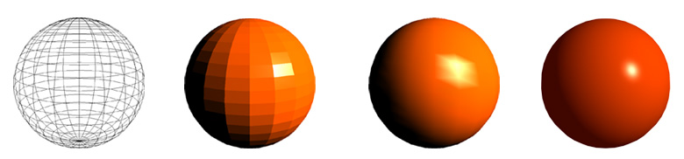
Comparison of Shading Models
Geometry
Flat Shading
Gouraud Shading
Phong Shading

Slide 24
OpenGL Code for Shading Models
For Flat shading model, command in OpenGL is
glShadeModel(GL_FLAT);
For Gouraud shading model, command OpenGL is
glShadeModel(GL_SMOOTH);
For Phong shading model,
OpenGL is not set up to do Phong shading,
You may write the code yourselves to do the task.

Slide 25
Texture Mapping

Slide 26
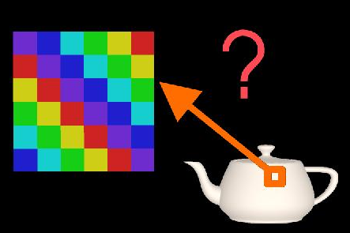
Texture Mapping
Modeling a complex surface is difficult because of the detail required and it would be difficult to render this fine detail accurately.
Texture mapping allows a simple polygon to appear to have a complex surface texture.
Texture mapping assigns pixel (or texel) values of a texture image to vertices on the object

Slide 27

Texture Mapping
OpenGL supports several types of textures such as 1D, 2D, 3D, cube, etc that can be used for different techniques.
A texture is a 2D image (a 2D array of colour values). Each pixel is called a texel
In OpenGL, the height and/ or width of a texture image must be the power of 2

Slide 28
Texture Mapping
Texture mapping finds colour/texture values for vertices by associating a texture coordinate (s, t) with each vertex, then use this texture coordinate (s, t) to index into the texture image.
The reason not to directly map a vertex to a texel in the image is because that would be too limiting, as replacing the texture image with one that has different width and/or height means that we will need to update the mapping.

Slide 29
Texture Coordinate
Texture coordinate (s, t) are specified in 'texture space' which is simply the normalized range [0,1].
t
(0,1)
(1,1)
(0,0)
(1,0)
s

Slide 30
Texture Coordinate
Multiplying the texture coordinate with the corresponding width and height of the texture image we get the location of the texel in the texture.
For example, if the texture coordinate is [0.5,0.1] and the texture image has a width of 300 and a height of 300, the texel location will be (150, 30):
0.5 * 300 = 150
0.1 * 300 = 30
Texture coordinates are the means by which texture image positions are assigned to vertices.

Slide 31
Locating Texel using Texture Coordinate
So we multiply texture coordinate (0.5, 0.1) with image width and height to locate a texel at (150, 30) in the texture image. The texture coordinate serves as an index into the texture image. Similarly we have:
(0,300) <= (0,1)
(300, 300) <= (1,1)
(0,0) <= (0,0)
(300, 0) <= (1,0)

Slide 32
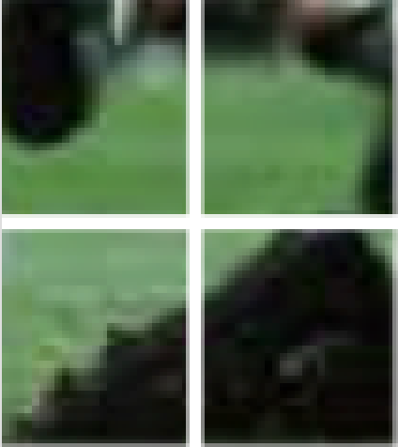
Filtering
However, texture coordinates may not exactly mapped to a texel in the texture image
Filtering interpolates a texel value from its neighbors or combine multiple texel values into one
Nearest neighbour - snap to the nearest texel
Bilinear interpolation – use distance­weighted average of the four nearest texels to estimate a new texel for the vertex

Slide 33
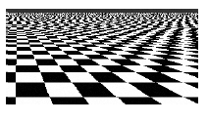
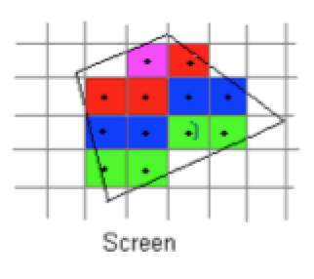
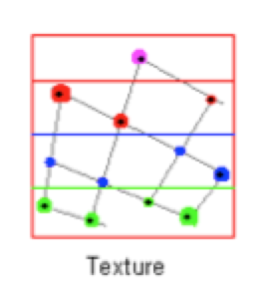
Texture Aliasing
Aliasing can happen that ruins the appearance of a textured object
Aliasing occurs when screen resolution differs from texture resolution - two adjacent pixels on object may not be mapped to two adjacent texels in the texture image

Slide 34
Texture Aliasing
Magnification aliasing
One texel (in blue below) to cover multiple pixels, as if the texel is magnified
Minification aliasing
Multiple texels (in blue below) to cover one pixel, as if the textels are minified

Slide 35
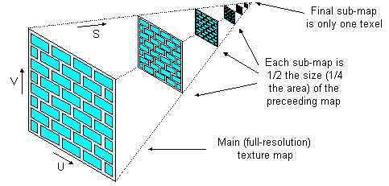
Mipmapping
Antialiasing methods may involve using a texture image that matches the resolution of the screen
A mipmap is an ordered set of arrays representing the same texture image at progressively lower resolutions – ‘mip’ stands for “many things in a small place”

Slide 36
Texture Mapping
For texture mapping you need to do the following:
Load a texture (into OpenGL)
Enable texture and bind the texture to the target
Provide texture coordinates for vertices, e.g.,
glTexCoord2f(0.0f, 1.0f);
glVertex3f(-0.5f, 0.5f, 0.5f);
Perform a sampling operation from the texture image using the texture coordinates to get the colour for the vertices

Slide 37
OpenGL Texture
glEnable(GL_TEXTURE_2D);
glEnable(GL_COLOR_MATERIAL);
glBindTexture(target, texture), for example glBindTexture(GL_TEXTURE_2D, texId) (this says texId (the loaded texture) is a 2D texture and is bounded to currently active texture unit.
glTexParameteri(target, pname, param);
target - Specifies the target texture of the active texture unit, which must be GL_TEXTURE_2D or GL_TEXTURE_CUBE_MAP.
pname - specifies the symbolic name of a single-valued texture parameter, including:
GL_TEXTURE_MIN_FILTER,
GL_TEXTURE_MAG_FILTER,
..

Slide 38
Setting Texturing Parameters
param - Specifies the value of pname. For example, params supplies functions for minifying the texture:
GL_NEAREST - returns the value of the nearest texel
GL_LINEAR - returns the weighted average of four texels
GL_NEAREST_MIPMAP_NEAREST - chooses the mipmap that most closely matches the size of the pixel being textured and uses the GL_NEAREST criterion
GL_LINEAR_MIPMAP_NEAREST - chooses the mipmap that most closely matches the size of the pixel being textured and uses the GL_LINEAR criterion.

Slide 39
Some Example Parameter Settings
glTexParameteri(GL_TEXTURE_2D, GL_TEXTURE_WRAP_S, GL_REPEAT); glTexParameteri(GL_TEXTURE_2D, GL_TEXTURE_WRAP_T, GL_REPEAT);
glTexParameter calls tell OpenGL that we will "tile" the texture, e.g., the texture will repeat if we go beyond its bounds.
glTexParameteri(GL_TEXTURE_2D, GL_TEXTURE_MAG_FILTER, GL_LINEAR); glTexParameteri(GL_TEXTURE_2D, GL_TEXTURE_MIN_FILTER, GL_LINEAR);
glTexParameter calls tell OpenGL that bilinear interpolation will be used to determine what the color is between pixels on a texture. The other option is GL_NEAREST, which is often faster, but not as good in quality.
glTexEnvf(GL_TEXTURE_ENV, GL_TEXTURE_ENV_MODE, GL_MODULATE); this sets the texture environment mode to GL_MODULATE, which means the surface color is multiplied by the texture colour (e.g., we want the surface intensity to vary depending on the lighting on the surface). If set to GL_REPLACE the surface will be drawn using the texture colour only

Slide 40
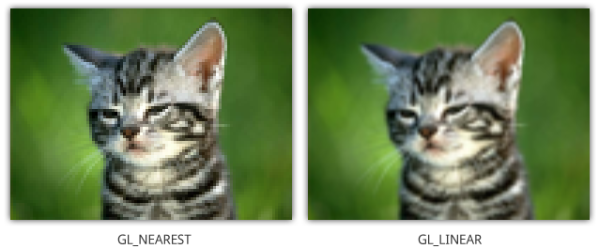
Filtering
GL_NEAREST: Returns the pixel that is closest to the coordinates.
GL_LINEAR: Returns the weighted average of the 4 pixels surrounding the given coordinates.

Slide 41
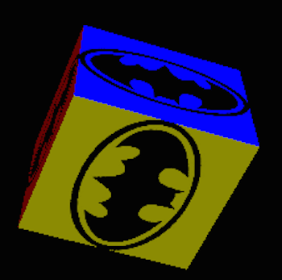
Demo 1: Texturing a Cube
glEnable(GL_TEXTURE_2D);
glEnable(GL_COLOR_MATERIAL);
glBindTexture(GL_TEXTURE_2D, texId);
glBegin(GL_QUADS);
glTexCoord2f(0.0f, 1.0f);
glVertex3f(-0.5f, 0.5f, 0.5f);
glTexCoord2f(0.0f, 0.0f);
glVertex3f(-0.5f,-0.5f, 0.5f);
glTexCoord2f(1.0f, 0.0f);
glVertex3f( 0.5f,-0.5f, 0.5f);
glTexCoord2f(1.0f, 1.0f);
glVertex3f( 0.5f, 0.5f, 0.5f);
glEnd()
Assign texture coordinates to vertices

Slide 42
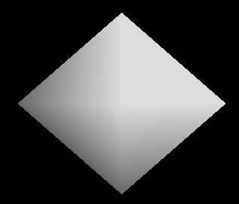
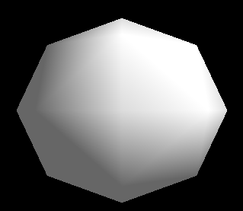
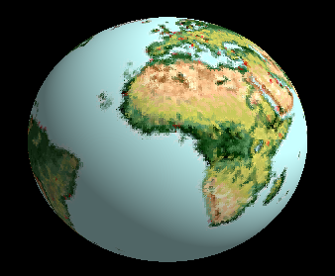
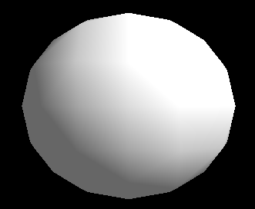
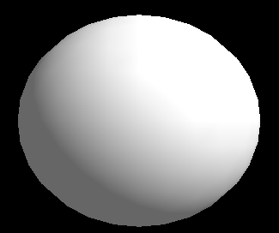
Demo 2: Texturing a Sphere

Slide 43
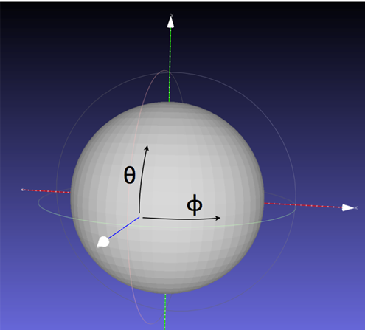
Spherical Coordinates
In a spherical coordinate system, a point on the sphere is represented by
(r, θ , φ), but r is constant, so we can ignore it.
Thus we can map a point on the sphere represented as (θ, φ) to a texture coordinate (s, t).
-90º <= <=90º;
-180º <= <=180º:
θ
https://www.youtube.com/watch?v=MiQWcD25K0w&feature=youtu.be
φ

Slide 44
Making a Sphere Through Surface Subdivision
We can start with an octahedron then call the subdivide() function on each of its 8 triangles until the triangles are small enough to be considered as vertices and the sphere is round enough
Vertices in spherical coordinate ( , )
Texture coordinates can then be assigned to vertices
θ
φ
e
Take each of the 8 triangles of the
octahedron and divide it into 4 triangles
b
c
a
d
f

Slide 45
Implementing Surface Subdivision
a
The Subdivide(recurse, a,b,c) function takes a triangle, say a,b,c, and subdivide it into 4 triangles: adf, dbe, fec, def, then calls itself on the 4 triangles (recursive program):
Subdivide(recurse-1, a, d, f);
Subdivide(recurse-1, d, b, e);
Subdivide(recurse-1, f, e, c);
Subdivide(recurse-1, f, d, e);
d
f
b
c
e
New vertices are then
‘nomalised’ to make sure they are on the unit sphere

Slide 46
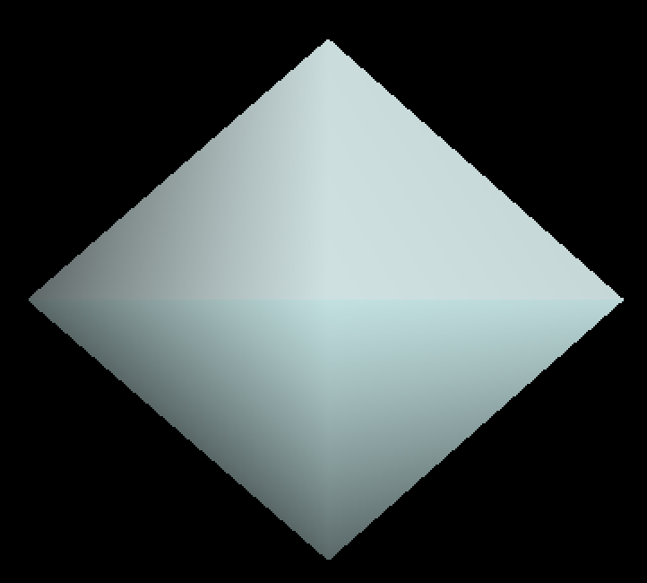
Making a Sphere Through Surface Subdivision
Initial 6 vertices (form 8 triangles)
a = (1, 0, 0); b = (0, 0, -1);
c = (-1, 0, 0); d = (0, 0, 1);
e = (0, 1, 0); f = (0, -1, 0);
Subdivide each of the 8 triangles:
Subdivide(recurse, d, a, e);
Subdivide(recurse, a, b, e);
Subdivide(recurse, b, c, e);
Subdivide(recurse, c, d, e);
Subdivide(recurse, a, d, f);
Subdivide(recurse, b, a, f);
Subdivide(recurse, c, b, f);
Subdivide(recurse, d, c, f);
e
c
d
a
f

Slide 47
Assigning Texture Coordinates to Vertices
In the texture sphere demo program, vertex a (represented by its normal as (a[0],a[1],a[2]) is given texture coordinates (s_{a}, t_{a}) as follows:
r = 1
sin = a[1] / r = a[1]
tan = a[0] / a[2]
s_{a} = atan2(a[0], a[2]) / (2 * 3.14) + 0.5;
t_{a} = asin(a[1]) / 3.14 + 0.5;
glTexCoord2f(sa, ta)
Similarly for vertices b and c.
θ
y
(a[0], a[1], a[2])
φ
r
(-PI, PI) =>(-0.5, 0.5) =>(0,1)
o
θ
x
(-PI/2, PI/2) =>(-0.5, 0.5)=>(0,1)
φ
z

Slide 48
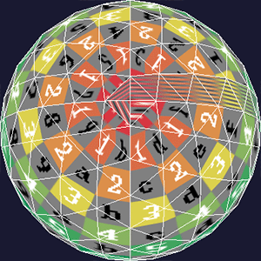
Texturing a Sphere
There is much higher texture resolution towards the pole
The (odd) colorful strip on the right side is due to the fact that on one side of the strip, (s, t) coordinates are 0.0, while the other is closer to 1.0.

